Slide 1
Memory Management
Course Instructor
Anam Akbar

Slide 2
Memory Management
Memory management is responsible for allocating memory to processes and for protecting the memory allocated to each process from undesired access by other processes.
It is also responsible for protecting the memory allocated to the operating system from unauthorized access.
Memory management is the functionality of an operating system which handles or manages primary memory and moves processes back and forth between main memory and disk during execution.
Memory management keeps track of each and every memory location, regardless of either it is allocated to some process or it is free. It checks how much memory is to be allocated to processes. It decides which process will get memory at what time. It tracks whenever some memory gets freed or unallocated and correspondingly it updates the status.

Slide 3
Memory management
The process address space is the set of logical addresses that a process references in its code. For example, when 32-bit addressing is in use, addresses can range from 0 to 0x7fffffff; that is, 2^31 possible numbers, for a total theoretical size of 2 gigabytes.
For a 64-bit process, the virtual address space is the 8-terabyte range 0x000'00000000 through 0x7FF'FFFFFFFF
In principle, a 64-bit microprocessor can address 16 EiBs (16 × 1024⁶ = 2⁶⁴ = 18,446,744,073,709,551,616 bytes, or about 18.4 exabytes) of memory. However, not all instruction sets, and not all processors implementing those instruction sets, support a full 64-bit virtual or physical address space.

Slide 4
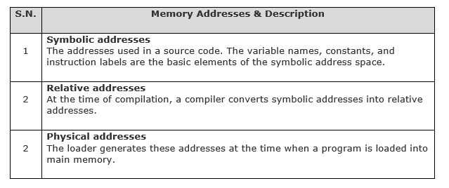
Memory Management

Slide 5
Memory Management
Single absolute partition
The simplest memory management scheme requires no hardware support.
Memory space is divided into two partitions by convention
- One partition is allocated to the operating system and
- The other to an executing process.
When a program is loaded into a partition, the addresses in the loaded code must correspond to the appropriate address in the partition.
- Addresses in the code may be bound to particular memory addresses at either compile time or load time, program that have been bound to memory locations at compile time are said to contain absolute code .

Slide 6
Memory Management
Virtual and physical addresses are the same in compile-time and load-time address-binding schemes. Virtual and physical addresses differ in execution-time address-binding scheme.
The set of all logical addresses generated by a program is referred to as a logical address space.
The set of all physical addresses corresponding to these logical addresses is referred to as a physical address space.
The runtime mapping from virtual to physical address is done by the memory management unit (MMU) which is a hardware device. MMU uses following mechanism to convert virtual address to physical address.
Protection can be incorporated into an absolute partition scheme by adding a hardware base register.

Slide 7
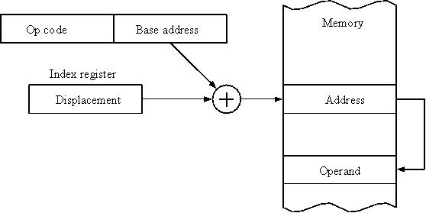
Memory Management
The value in the base register is added to every address generated by a user process, which is treated as offset at the time it is sent to memory.
For example, if the base register value is 10000, then an attempt by the user to use address location 100 will be dynamically reallocated to location 10100.
The user program deals with virtual addresses; it never sees the real physical addresses.

Slide 8
Memory Management
Base Register
Logical address
>
Yes
physical address
Memory
No
Trap addressing Error
Base register addressing

Slide 9
Memory Management
A user program is allocated to partition2
Suppose user now want to
Access address no:108(logical address)
108<size(200)
108+Base=physical address
108+300=408
OS
Partition
Partition
Partition
200
300
500

Slide 10
Memory Management
Static vs Dynamic Loading
The choice between Static or Dynamic Loading is to be made at the time of computer program being developed.
If you have to load your program statically, then at the time of compilation, the complete programs will be compiled and linked without leaving any external program or module dependency.
The linker combines the object program with other necessary object modules into an absolute program, which also includes logical addresses.

Slide 11
Memory Management
Static vs Dynamic Loading
If you are writing a Dynamically loaded program, then your compiler will compile the program and for all the modules which you want to include dynamically, only references will be provided and rest of the work will be done at the time of execution.
At the time of loading, with static loading, the absolute program (and data) is loaded into memory in order for execution to start.
If you are using dynamic loading, dynamic routines of the library are stored on a disk in relocatable form and are loaded into memory only when they are needed by the program.

Slide 12
Memory Management
Static vs Dynamic Linking
As explained above, when static linking is used, the linker combines all other modules needed by a program into a single executable program to avoid any runtime dependency.
When dynamic linking is used, it is not required to link the actual module or library with the program, rather a reference to the dynamic module is provided at the time of compilation and linking. Dynamic Link Libraries (DLL) in Windows and Shared Objects in Unix are good examples of dynamic libraries.

Slide 13
Memory Management
Swapping
Swapping is a mechanism in which a process can be swapped temporarily out of main memory (or move) to secondary storage (disk) and make that memory available to other processes. At some later time, the system swaps back the process from the secondary storage to main memory.
Though performance is usually affected by swapping process but it helps in running multiple and big processes in parallel and that's the reason Swapping is also known as a technique for memory compaction.

Slide 14
Memory Management
Swapping
The total time taken by swapping process includes the time it takes to move the entire process to a secondary disk and then to copy the process back to memory, as well as the time the process takes to regain main memory.
Let us assume that the user process is of size 2048KB and on a standard hard disk where swapping will take place has a data transfer rate around 1 MB per second. The actual transfer of the 1000K process to or from memory will take
2048KB / 1024KB per second
= 2 seconds
= 200 milliseconds
Now considering in and out time, it will take complete 400 milliseconds plus other overhead where the process competes to regain main memory.

Slide 15
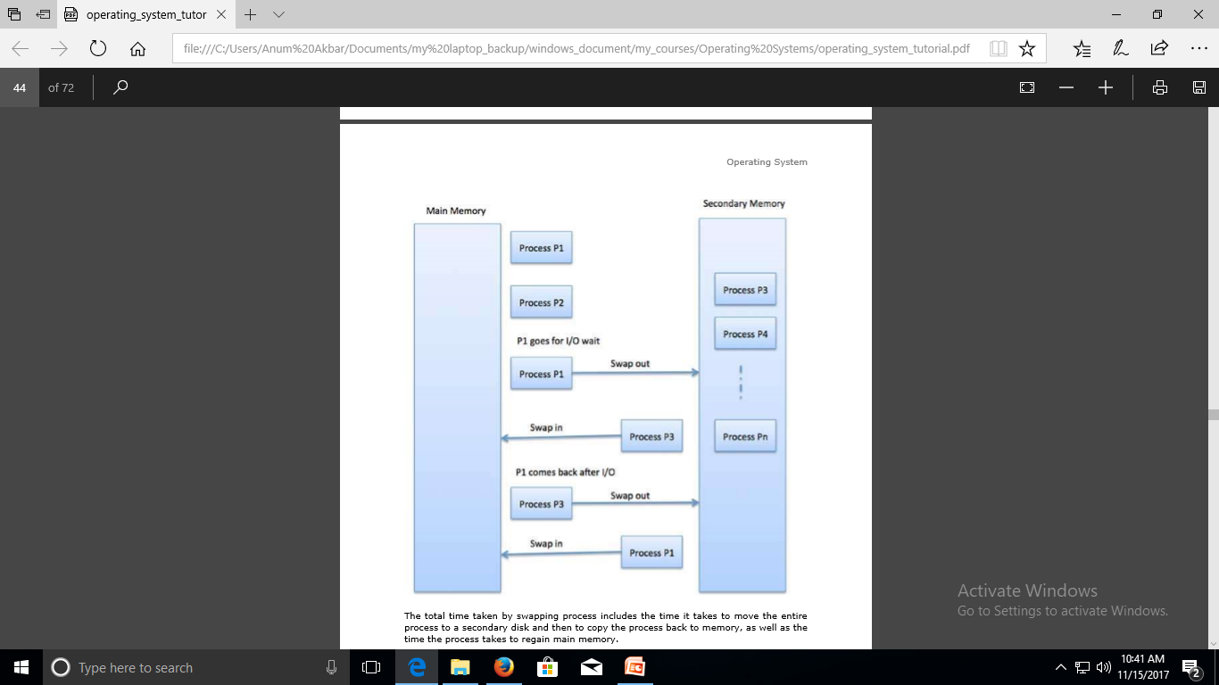
Memory Management

Slide 16
Memory Management
Memory Allocation
Main memory usually has two partitions:
Low Memory -- Operating system resides in this memory.
High Memory -- User processes are held in high memory.

Slide 17
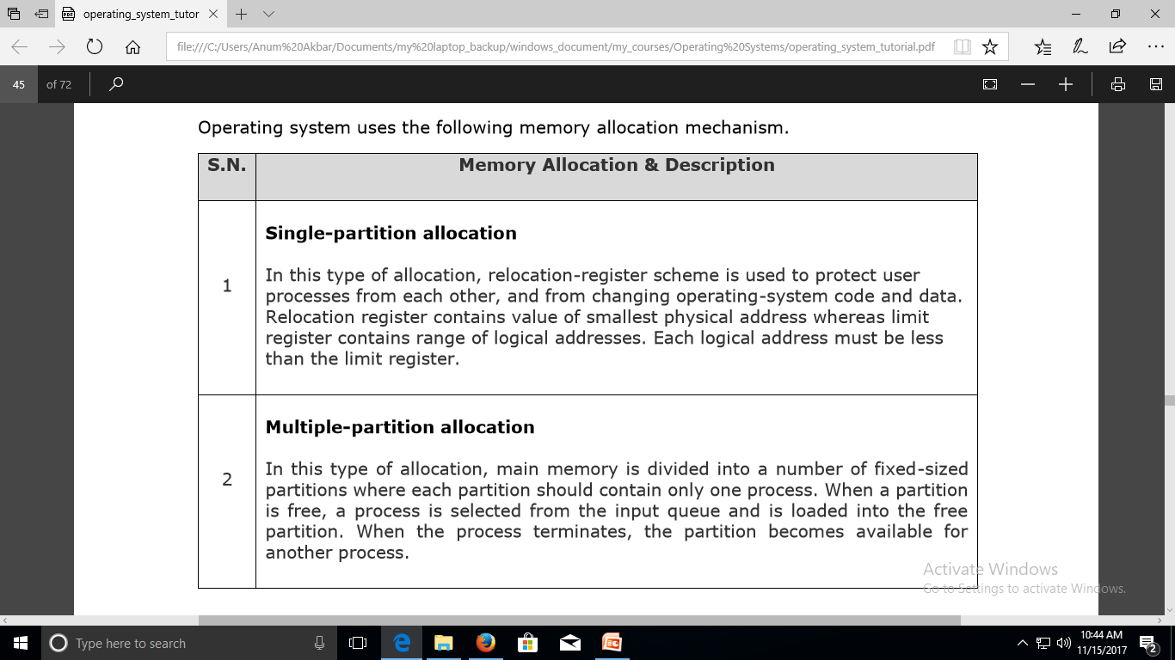
Memory Management

Slide 18
Memory Management
_{Fragmentation}
As processes are loaded and removed from memory, the free memory space is broken into little pieces. It happens after sometimes that processes cannot be allocated to memory blocks considering their small size and memory blocks remains unused. This problem is known as Fragmentation.

Slide 19
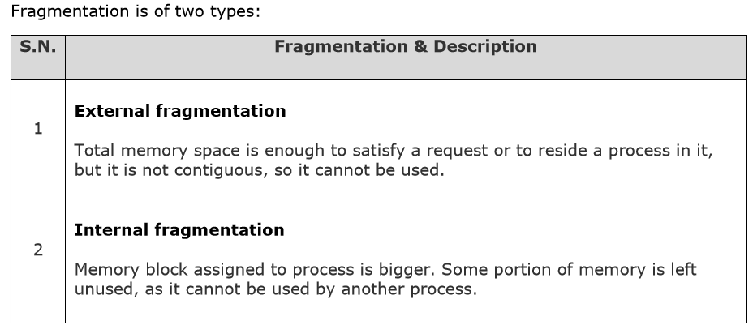
Memory Management
_{Fragmentation}

Slide 20
Memory Management
_{Fragmentation}

Slide 21
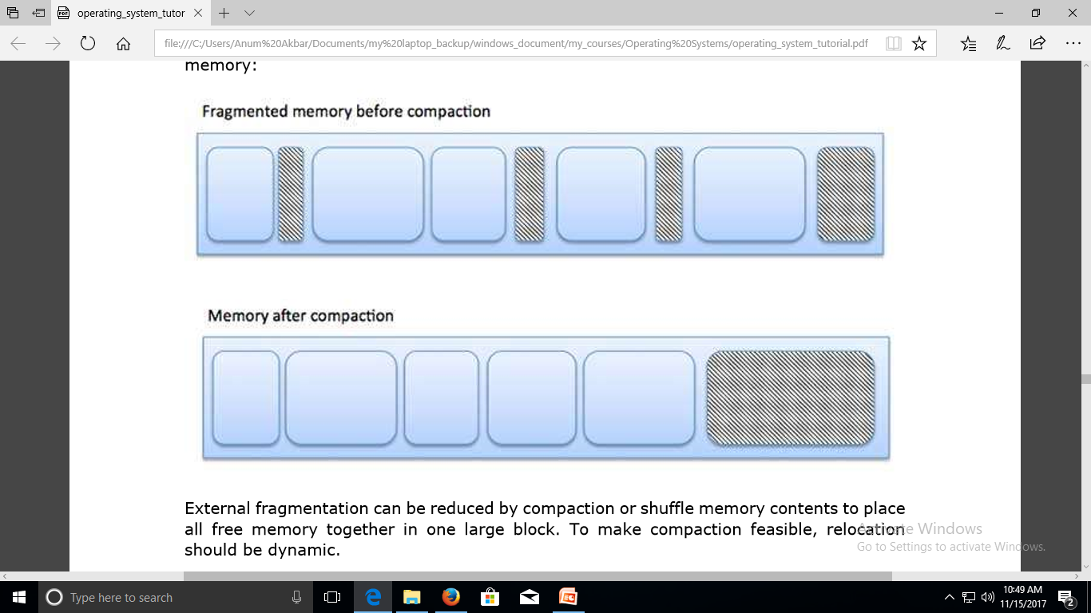
Memory Management

Slide 22
Memory Management
External fragmentation can be reduced by compaction or shuffle memory contents to place all free memory together in one large block. To make compaction feasible, relocation should be dynamic.
The internal fragmentation can be reduced by effectively assigning the smallest partition but large enough for the process.

Slide 23
Memory Management
Partition Selection Algorithm/ Placement policies
In situation where multiple memory holes are large enough to contain a process , the operating system must use an algorithm to select which hole the process will be loaded into.
-First Fit
-Next Fit
-Best Fit
-Worst Fit.

Slide 24
Memory Management
Partition Selection Algorithm/ Placement policies
First Fit:
-The Operating system looks at all sections of free memory.
- The process is allocated to the first hole found that is larger than the size of the process.
-Unless the size of the process matches the size of the hole, the hole continues to exist, reduced by the size of the process.
Next Fit:
-It attempts to improve performance by distributing its searches more evenly over the entire memory space.
-It does this by keeping track of which hole was last allocated.
-The next search starts at the last hole allocated, not at the beginning of the memory.

Slide 25
Memory Management
Partition Selection Algorithm/ Placement policies
Best Fit:
- It searches the entire list of holes to find the smallest hole whose size is greater than or equal to size of process.
Worst Fit:
-It is the opposite of Best Fit.
-It always picks the largest remaining hole.

Slide 26
Memory Management
Partition Selection Algorithm/ Placement policies
P1:20k
P2:10k
P3:5k
A:10k
B:30k
c:5k first fit: p1→B1, p2→A, p3→B2
D:20k Next fit:p1→B1,p2→B2, p3→ C
E:15k Best fit: p1→D, p2→A, p3→ C
F:20k Worst fit: p1→ B, p2→D, p3→ E
A:10k | - | B:30k | B2 | - | C:5k | - | D:20k | - | C:15k | - | F:20k
10khole

Slide 27
Memory Management
Partition Selection Algorithm/ Placement policies
Buddy System
-A buddy system offers a compromise between fixed-size and variable-size allocation.
-Memory is allocated in units that are power of 2.
-Initially there is a single allocation unit that comprises all of memory.
- When memory is allocated a unit memory whose size is the smallest power of 2 larger than the size of the process.

Slide 28
Memory Management
Partition Selection Algorithm/ Placement policies
Buddy System
A:50
B:150
C:60
D:60
E:60

Slide 29
Memory Management
1MB
512 |  |  |  |  | 512
256 |  |  |  | 256 | 512
128 |  | 128 |  | 256 | 512
64A | 64 | 128 |  | 256 | 512
A | 64 | 128 |  | B | 512
A | C | 128 |  | B | 512
A | C | D | 64 | B | 512
A | C | D | E | B | 512
A | C | 64 | E | B | 512
A | 64 | 64 | E | B | 512
A | 64 | 64 | E | B | 512
64 | 64 | 64 | 64 | B | 512
F |  | 64 | 64 | B | 512
F |  | G |  | B | 512
128 |  | G |  | 256 | 512
128 |  | 128 |  | 256 | 512
512 |  |  |  |  | 512
1MB
Partition Selection Algorithm/ Placement policies
D Exit
C Exit
E Exit
A Exit
F 125 k
G 120 k
F ,BExit
G Exit

Slide 30
Memory Management
Paging
A computer can address more memory than the amount physically installed on the system. This extra memory is actually called virtual memory and it is a section of a hard that's set up to emulate the computer's RAM. Paging technique plays an important role in implementing virtual memory.
Paging is a memory management technique in which process address space is broken into blocks of the same size called pages (size is power of 2, between 512 bytes and 8192 bytes). The size of the process is measured in the number of pages.

Slide 31
Memory Management
Paging
Similarly, main memory is divided into small fixed-sized blocks of (physical) memory called frames and the size of a frame is kept the same as that of a page to have optimum utilization of the main memory and to avoid external fragmentation.

Slide 32
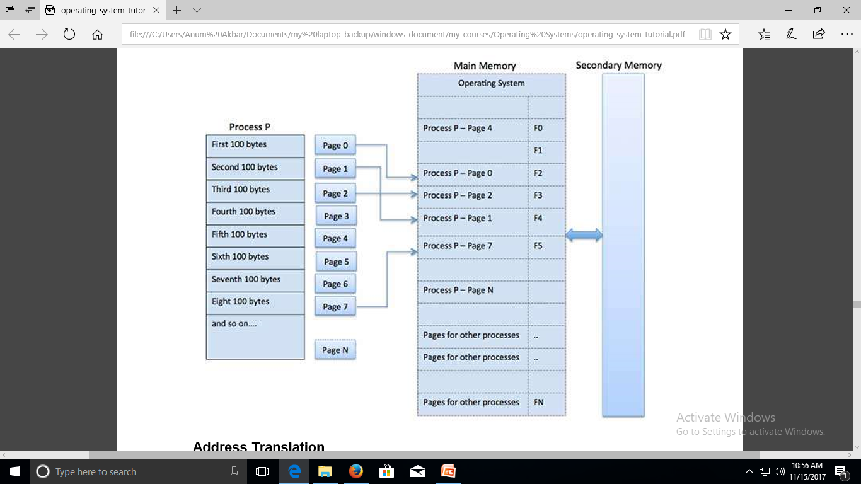
Memory Management
Paging

Slide 33
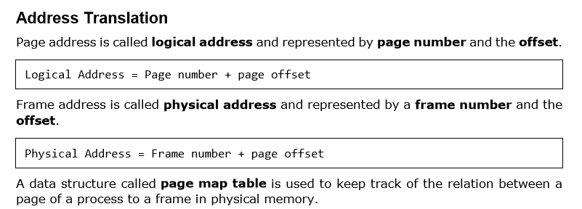
Memory Management

Slide 34
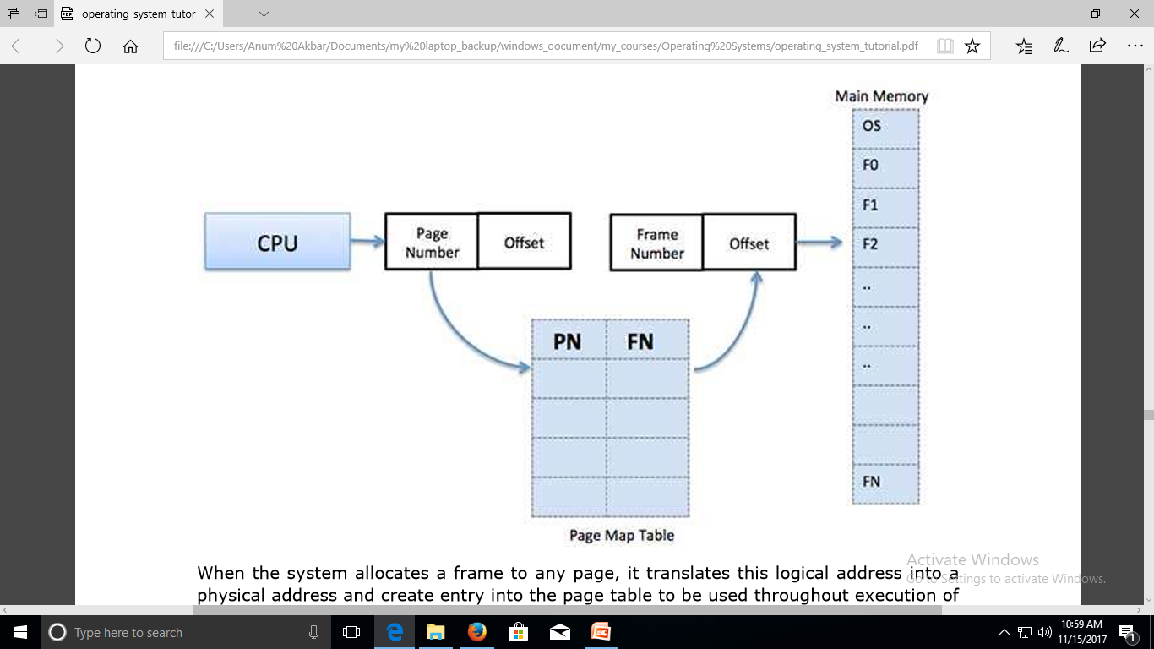
Memory Management

Slide 35
Memory Management
When the system allocates a frame to any page, it translates this logical address into a physical address and create entry into the page table to be used throughout execution of the program.
When a process is to be executed, its corresponding pages are loaded into any available memory frames. Suppose you have a program of 8Kb but your memory can accommodate only 5Kb at a given point in time, then the paging concept will come into picture. When a computer runs out of RAM, the operating system (OS) will move idle or unwanted pages of memory to secondary memory to free up RAM for other processes and brings them back when needed by the program.
This process continues during the whole execution of the program where the OS keeps removing idle pages from the main memory and write them onto the secondary memory and bring them back when required by the program.

Slide 36
Memory Management
Page No | Address
0000 | 0000
0001 | 1024
0010 | 2048
0011 | 3072
0100 | 4096
0101 | 5120
0110 | 6144
0111 | 7168
Paging
Page table:4 bit
Offset:10bit
Size:?
Page size=1024=1KB
No.of.pages:16
Memory size:16 X1 KB
=16KB
Process A page: 0010, 0110
Process B page:0011,0101
Offset/displacement
Page table entry
0010 0000111100
2048
120
2048+120=2168

Slide 37
Memory Management
Paging
Memory size=2^24
Page:64 KB=2^16
No.of pages=?
2^24/2^16= no.of pages
2^24-16= no.of pages
2^8= no.of pages
=256
2^10 | 2^11 | 2^12 | 2^13 | 2^14 | 2^15 | 2^16 | 2^17 | 2^18 | 2^19 | 2^20 | 2^21 | 2^22 | 2^23 | 2^24
1k | 2k | 4K | 8K | 16k | 32k | 64k | 128k | 256k | 512k | 1MB | 2MB | 4MB | 8MB | 16MB

Slide 38
Memory Management
Advantages and Disadvantages of Paging
Here is a list of advantages and disadvantages of paging:
- Paging reduces external fragmentation, but still suffer from internal fragmentation.
-Paging is simple to implement and assumed as an efficient memory management technique.
- Due to equal size of the pages and frames, swapping becomes very easy.
-Page table requires extra memory space, so may not be good for a system having small RAM.

Slide 39
Memory Management
Segmentation
Segmentation is a memory management technique in which each job is divided into several segments of different sizes, one for each module that contains pieces that perform related functions. Each segment is actually a different logical address space of the program.
When a process is to be executed, its corresponding segmentation are loaded into noncontiguous memory though every segment is loaded into a contiguous block of available memory.
Segmentation memory management works very similar to paging but here segments are of variable-length where as in paging pages are of fixed size.
A program segment contains the program's main function, utility functions, data structures, and so on. The operating system maintains a segment map table for every process and a list of free memory blocks along with segment numbers, their size and corresponding memory locations in main memory. For each segment, the table stores the starting address of the segment and the length of the segment. A reference to a memory location includes a value that identifies a segment and an offset.

Slide 40
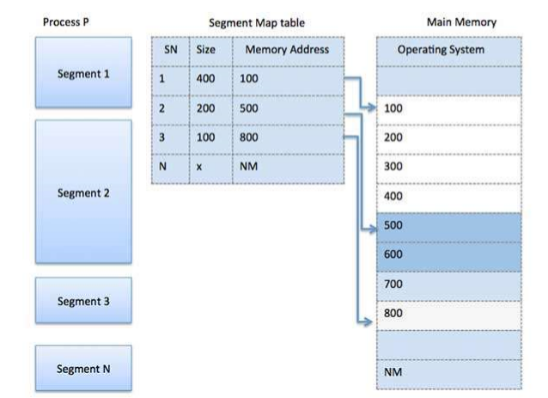
Memory Management

Slide 41
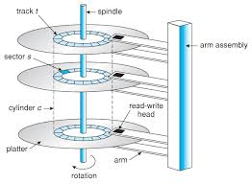
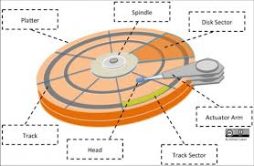
Device Management
Storage disk
Disk storage (also sometimes called the drive storage) is a general category of storage mechanisms where data are recorded by various electronic, magnetic, optical, or mechanical changes to a surface layer of one or more rotating disks.

Slide 42
Device Management
Cylinder
All tracks are at a particular head position.
Formatting:
We build sectors in Low level formatting Or physical formatting
Disadvantage:
One revolution get waisted.
8
1
7
2
6
3
5
4
No interleaving
Revolution per minute :rpm

Slide 43
Device Management
8
6
1
1
5
3
4
4
2
8
7
7
3
6
5
2
Single interleaving
Double interleaving

Slide 44
Device Managementent
Hard Disk Performance
A-Seek Time:
Time require to move head to a particular cylinder.
Seek time depends on:
-Startup delays (To initiate head movement (I))
-Rate if movement of head(H)(Time required to move to the adjacent cylinder)
-How far the head must travel (C) Or number of cylinders away from current position
So
Seek Time(s)= HC+I

Slide 45
Device Management
Hard Disk Performance
B- Latency:
Latency L , is the amount of time it takes the start of information to be accessed to spin under the read/ write head.
On average that will be one-half of one revolution.
Thus, latency can be computed by dividing the number of revolutions per minute (R) into 30.
L=30/R

Slide 46
Device Management
Hard Disk Performance
C- Transfer Time
The transfer time, T, is determined by the amount of information to be read B; the number of bytes per track, N; and rotational speed
T= 60B/RN
Total access time is the sum of the three factors
A=S+L+T

Slide 47
Device Management
Hard Disk Scheduling
The amount of head movement needed to satisfy a series of I/O requests can effect performance.
For this reason, a number of algorithms have been proposed for scheduling disk I?O rrequests.
FIFO: Service requests in the order they are received.
Priority: Service requests according to a priority associated with the requesting process.
SSTF: Shortest Seek Time First services the request whose track position is closet to the current track position.
Requests are subject to starvation with this algorithm.

Slide 48
Device Management
Hard Disk Scheduling
SCAN: Move the read /write head back and forth between the inner most outermost track.
As the head gets to each track, satisfy all outstanding requests for that track. Starvation is possible but only if there are repeated requests for the current track.
Look: Start the head moving in one direction. Satisfy the request for the closet track in that direction.
When there are no more requests in the direction the head is travelling, reverse direction and repeat.
This algorithm is similar to SCAN, but unlike SCAN the head does not unnecessarily travel to the innermost and outermost track on each circuit.

Slide 49
Device Management
Hard Disk Scheduling
C-SCAN and C-LOOK:
Circular version of Scan And LOOK that only satisfy the request while going in one direction.
When the last track has been reached, these algorithms return to starting track.
This reduces the maximum delay before a request will be serviced.

Slide 50
Device Management
Hard Disk Scheduling
N-step SCAN:
The request queue is divided into sub queues with each sub queue having a maximum length of N.
Sub queues are processed in FIFO order .
Within a sub queue, request are processed using SCAN.
While a sub queue is being serviced, incoming request are placed in the next non-filled sub queue.
N-step SCAN eliminates any possibility of starvation.
FSCAN:
Like N-step SCAN but with two sub queues, each of unlimited length, each of unlimited length.
While requests in one sub queue are serviced, new request are placed in the other sub queue.

Slide 51
Device Management
Redundant Array of Inexpensive Disks(RAID):
- It may be used to increase disk reliability
- RAID may be implemented in hardware or in the operating system.
- Six different types of RAID systems have been defined
Raid level 0:
- One large Virtual disk from a number of smaller disks.
-Storage is grouped into logical units called strips with the size of a strip being some multiple (possibly one) of the sector size.
-The Virtual storage is a sequence of strips interleaved among the disk in the array.

Slide 52
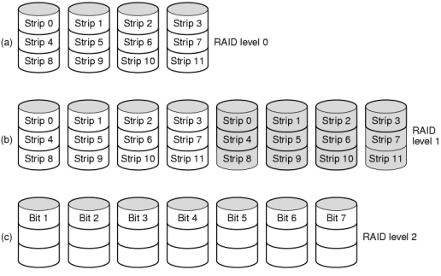
Device Management
Redundant Array of Inexpensive Disks(RAID):
Raid level 0:
-The principle benefit of RAID-0 is the ability to create a large disk.
- Its reliability benefits are limited
-Files tends to get scattered over a number of disks, so even after a disk failure, some file data may be scattered over a number of disk so, even after a disk failure, some file data may be retrievable.
- Performance benefits can be achieved when accessing sequentially stored data.
- On a RAID-0 system, sequential data is stored on different disks.
-While the first disk is in the process of reading the first strip, the second disk can start reading the second strip.

Slide 53
Device Management
Redundant Array of Inexpensive Disks(RAID):
Raid level 0:
-If there are N disk in the Array , N I/O operations can be occurring Concurrently.
-The process of overlapping requests in this fashion is known as pipelining.
RAID level1:
Data are stored twice by writing them to both the data drive (or set of data drives) and a mirror drive (or set of drives). If a drive fails, the controller uses either the data drive or the mirror drive for data recovery and continues operation. You need at least 2 drives for a RAID 1 array.

Slide 54
Device Management
Redundant Array of Inexpensive Disks(RAID):
RAID level1
Advantages
RAID 1 offers excellent read speed and a write-speed that is comparable to that of a single drive.
In case a drive fails, data do not have to be rebuild, they just have to be copied to the replacement drive.
RAID 1 is a very simple technology.
Disadvantages
The main disadvantage is that the effective storage capacity is only half of the total drive capacity because all data get written twice.
Software RAID 1 solutions do not always allow a hot swap of a failed drive. That means the failed drive can only be replaced after powering down the computer it is attached to. For servers that are used simultaneously by many people, this may not be acceptable. Such systems typically use hardware controllers that do support hot swapping.

Slide 55
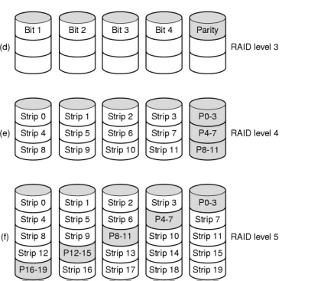
Device Management
Redundant Array of Inexpensive Disks(RAID):
RAID level 2 to 5
-Single copies of each strip are maintained.
-Redundant information maintain functionality despite disk failures.
-In RAID level 2, an error correcting code(such as hamming code) is calculated for the corresponding bits in each data disk.
-The bits of code are stored on multiple derives.
-The stripes are very small, so when a block is read, all disk are read in parallel

Slide 56
Device Management
Redundant Array of Inexpensive Disks(RAID):
RAID level 2 to 5
RAID-3 is similar but a single parity bit is used instead of error correcting code.
RAID-3 required just one extra disk. If any disk in the array fails, its data can be determined from the data on the remaining disks.
RAID level 4 is similar to RAID-3 except strips are larger, so an operation to read a block involves only a single disk.
Write operations require parity information to be calculated, and writes must be performed on both the data and the parity disk.

Slide 57
Device Management
Redundant Array of Inexpensive Disks(RAID):
Since the parity disk must be written whenever any data disk is written , the parity disk can become a bottle neck during the periods of heavy write activity.
RAID 5: RAID level 5 is similar to RAID level 4, except parity information is distributed across all disk.
RAID 5 eliminates the potential bottleneck found in RAID-4

Slide 58
Virtual Memory
-A computer can address more memory than the amount physically installed on the system.
- This extra memory is actually called virtual memory and it is a section of a hard disk that's set up to emulate the computer's RAM.
-The main visible advantage of this scheme is that programs can be larger than physical memory.
-Virtual memory serves two purposes.
First, it allows us to extend the use of physical memory by using disk.
Second, it allows us to have memory protection, because each virtual address is translated to a physical address.

Slide 59
Virtual Memory
Following are the situations, when entire program is not required to be loaded fully in main memory.
User written error handling routines are used only when an error occurred in the data or computation.
Certain options and features of a program may be used rarely.
Many tables are assigned a fixed amount of address space even though only a small amount of the table is actually used.

Slide 60
Virtual Memory
-The ability to execute a program that is only partially in memory would counter many benefits.
-Less number of I/O would be needed to load or swap each user program into memory.
-A program would no longer be constrained by the amount of physical memory that is available.
-Each user program could take less physical memory, more programs could be run the same time, with a corresponding increase in CPU utilization and throughput.

Slide 61
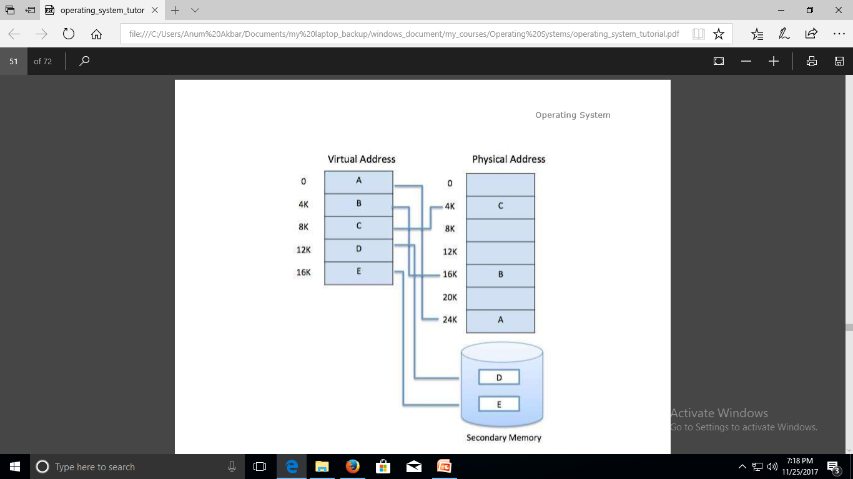
Virtual Memory
Modern microprocessors intended for general-purpose use, a memory management unit, or MMU, is built into the hardware. The MMU's job is to translate virtual addresses into physical addresses.
Virtual memory is commonly implemented by demand paging. It can also be implemented in a segmentation system. Demand segmentation can also be used to provide virtual memory.

Slide 62
Virtual Memory
Modern microprocessors intended for general-purpose use, a memory management unit, or MMU, is built into the hardware. The MMU's job is to translate virtual addresses into physical addresses.
Virtual memory is commonly implemented by demand paging. It can also be implemented in a segmentation system. Demand segmentation can also be used to provide virtual memory
Demand Paging
A demand paging system is quite similar to a paging system with swapping where processes reside in secondary memory and pages are loaded only on demand, not in advance.
When a context switch occurs, the operating system does not copy any of the old program’s pages out to the disk or any of the new program’s pages into the main memory Instead, it just begins executing the new program after loading the first page and fetches that program’s pages as they are referenced.

Slide 63
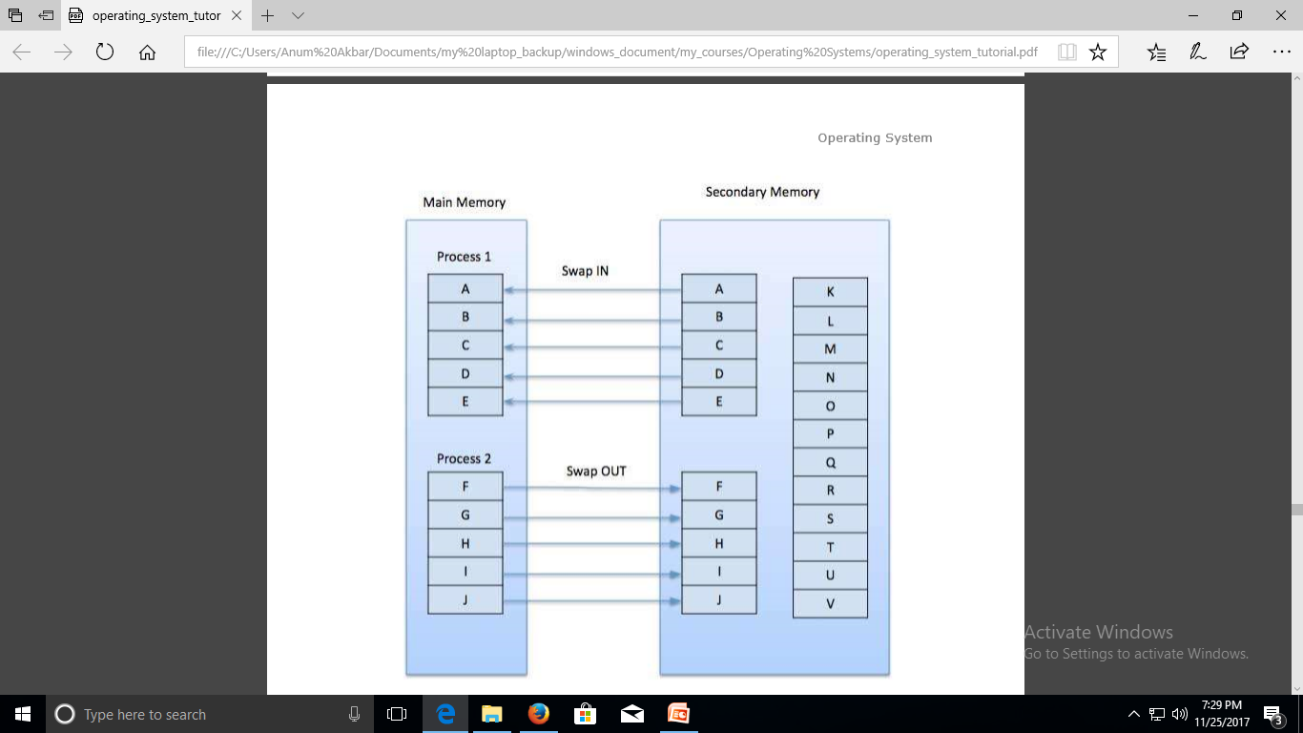
Virtual Memory
While executing a program, if the program references a page which is not available in the main memory because it was swapped out a little ago, the processor treats this invalid memory reference as a page fault and transfers control from the program to the operating system to demand the page back into the memory.

Slide 64
Virtual Memory
Advantages
Large virtual memory.
More efficient use of memory.
There is no limit on degree of multiprogramming.
Disadvantage
Number of tables and the amount of processor overhead for handling page interrupts are greater than in the case of the simple paged management techniques.

Slide 65
Virtual Memory
Page fault:
If a page is referred and it is not found in RAM or we can say IN/OUT bit are not set then the page fault occur.
How Page fault can be Remove:
- The RAM again copy that page with IN/OUT bit, but firstly copy the page in virtual memory , which is at its position.
- But it is a time consuming Job.
- If we want to know which page is required deletion, then we copy the same page in the RAM and add dirty bit in the page table.

Slide 66
Virtual Memory
Dirty page:
A page with different content in RAM and in Virtual memory is called DIRTY PAGE.
Locality Of Reference:
Reference String
The ordered list of page number accessed by a process is called its reference string.
For example, consider the following sequence of addresses - 123,215,600,1234,76,96
If page size is 100, then the reference string is 1,2,6,12,0,0
Locality: Locality results in the high ratio of presence of a page in RAM as compared to Virtual Memory
Temporal Locality:
If a memory location has been referenced there is a good chance it will be referenced again in a short period of time.

Slide 67
Virtual Memory
Spatial Locality:
It refers to the fact that if a memory location is exists it is likely that a location nearby will be accessed in the next instruction.
Page replacement algorithms:
FIFO(First In First Out):
Oldest page in main memory is the one which will be selected for replacement.
Easy to implement, keep a list, replace pages from the tail and add new pages at the head.

Slide 68
Virtual Memory
Least Recently Used (LRU) Algorithm
Page which has not been used for the longest time in main memory is the one which will be selected for replacement.
Easy to implement, keep a list, replace pages by looking back into time.

Slide 69
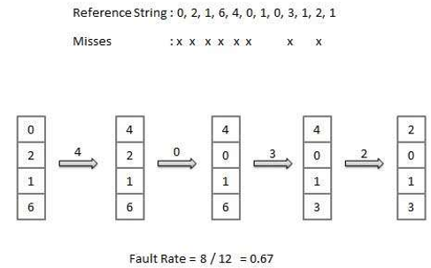
Virtual Memory

Slide 70
Virtual Memory
Page Buffering Algorithm
To get a process start quickly, keep a pool of free frames.
On page fault, select a page to be replaced.
Write the new page in the frame of free pool, mark the page table and restart the process.
Now write the dirty page out of disk and place the frame holding replaced page in free pool.

Slide 71
Virtual Memory
Least Frequently Used (LFU) Algorithm
The page with the smallest count is the one which will be selected for replacement.
This algorithm suffers from the situation in which a page is used heavily during the initial phase of a process, but then is never used again.
Most Frequently Used (MFU) Algorithm
This algorithm is based on the argument that the page with the smallest count was probably just brought in and has yet to be used.

